Slide 1

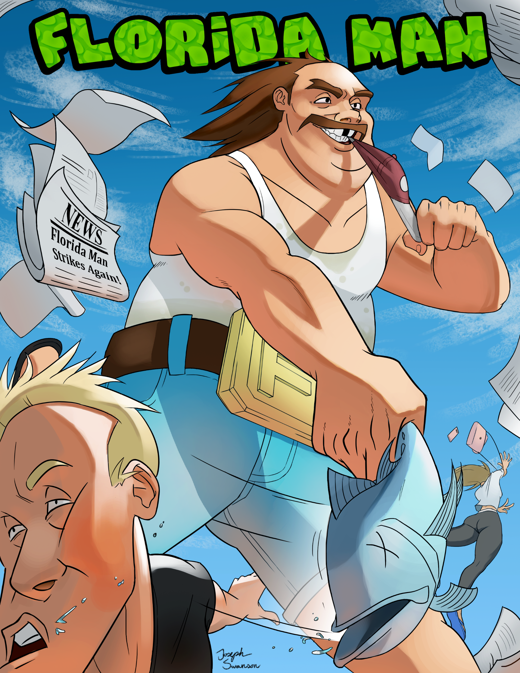
Joe Swanson – Lead Designer, Art Director
Gus Dubetz – Project Manager, Level Design
Jesse Plaetz – 3D Artist, UI Artist
Austin Krieger – Programmer
Gabe Landwehr – Programmer
Quinton Halliday – Level Designer, Narrative, Utility
Dillon Johnson – Level Designer, Narrative, Utility

Slide 2
Core Experience
Explore a suburban town through the twisted perception of Florida Man, causing discomfort and mayhem along the way in an effort to gain infamy through wacky newspaper headlines.

Slide 3
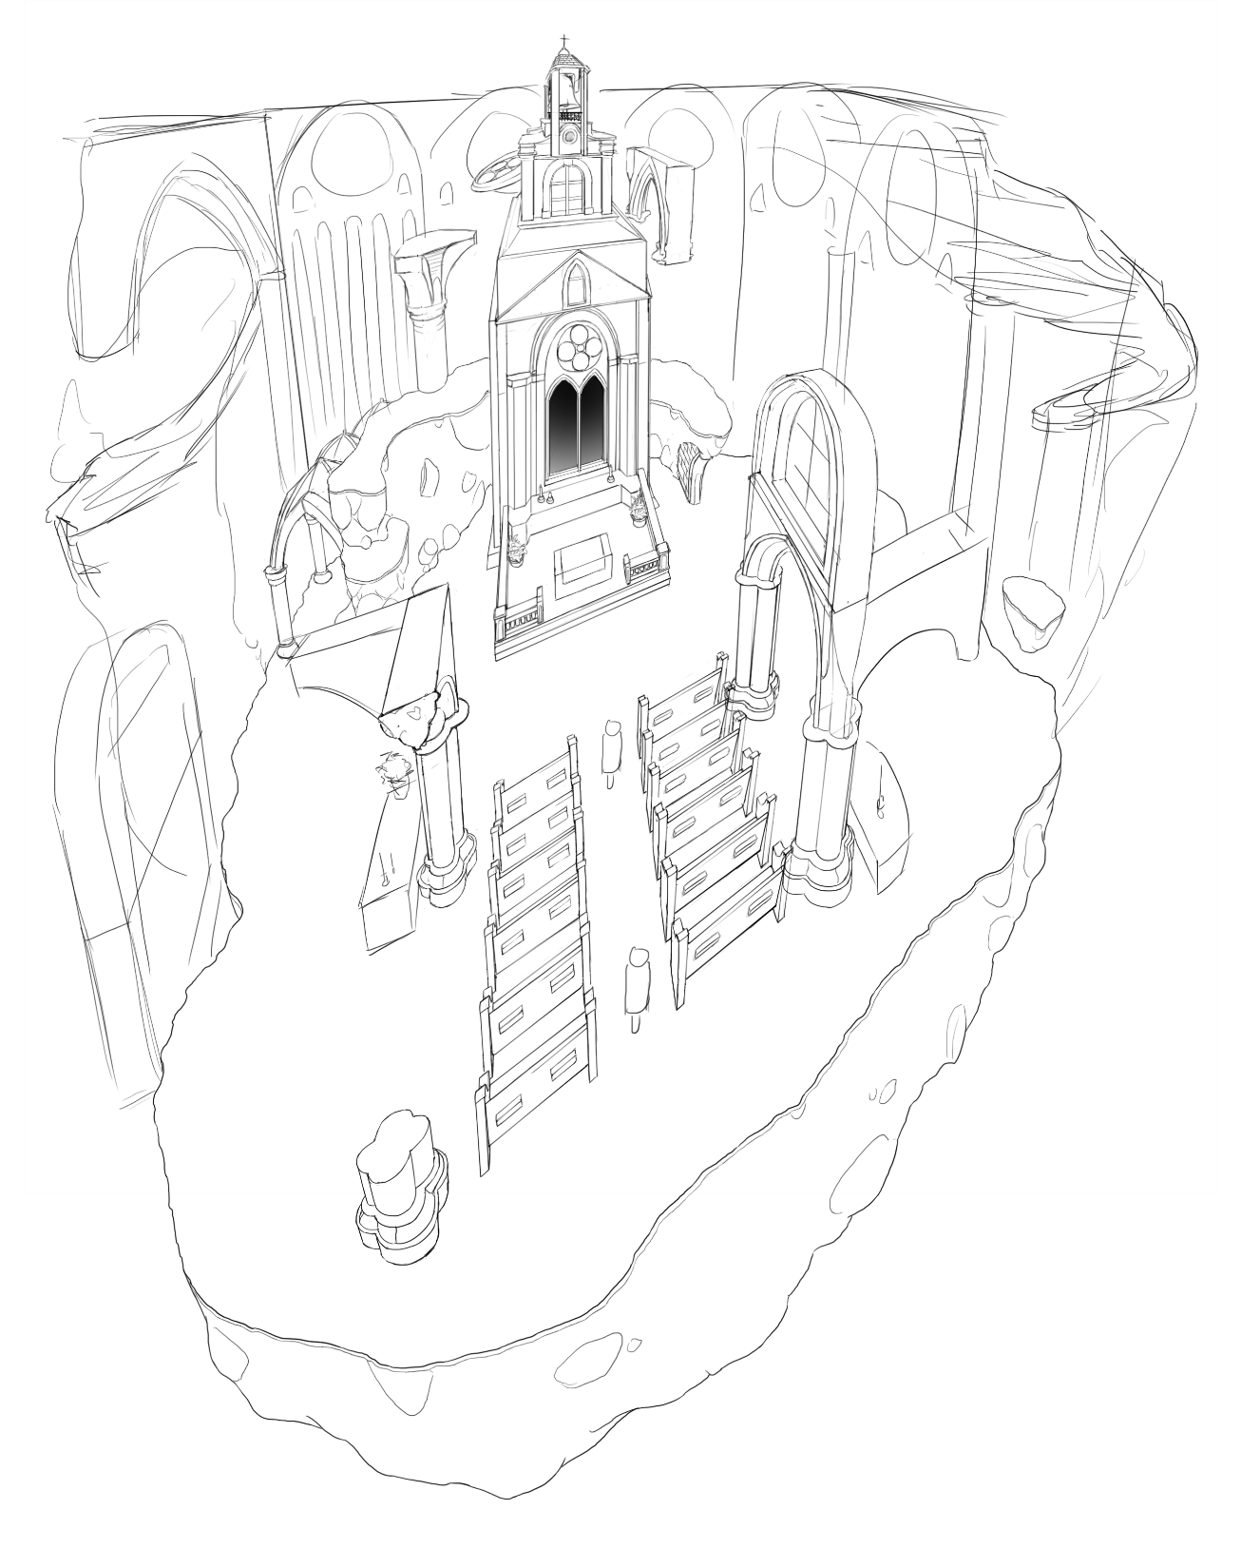
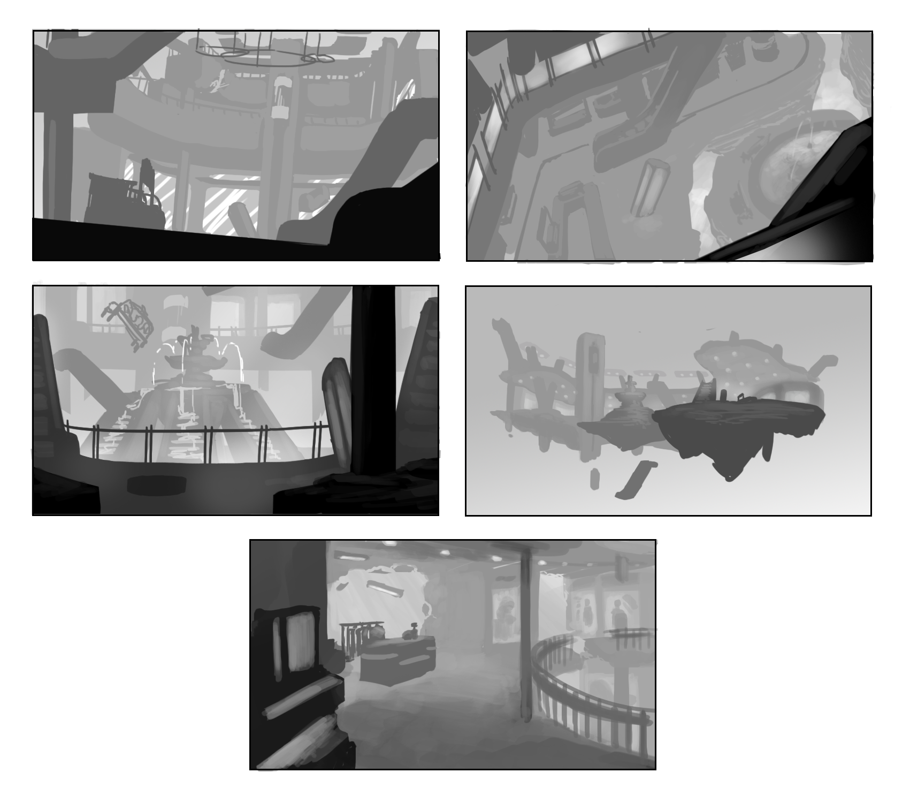
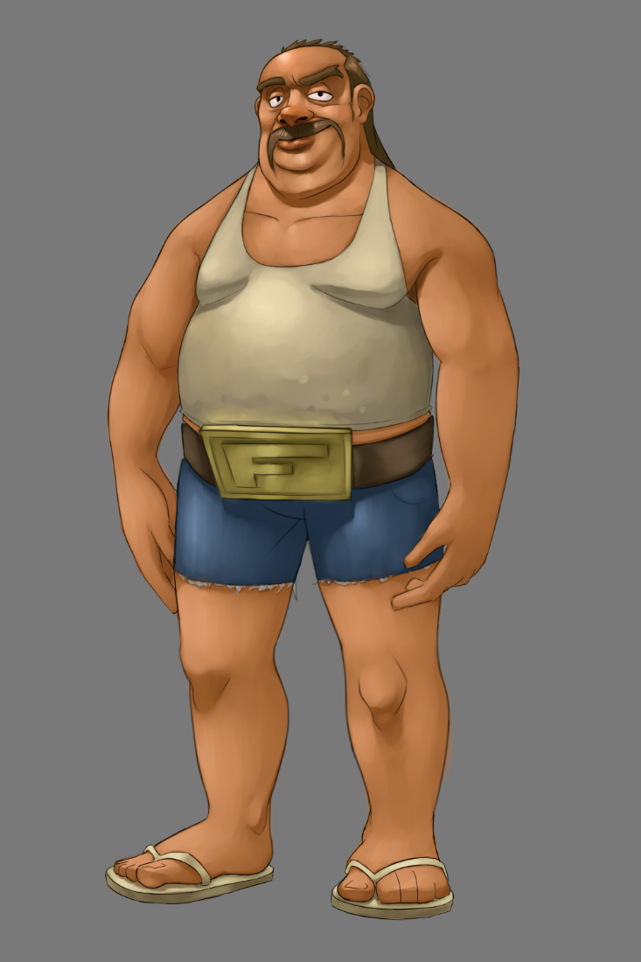
CONCEPT ART

Slide 4
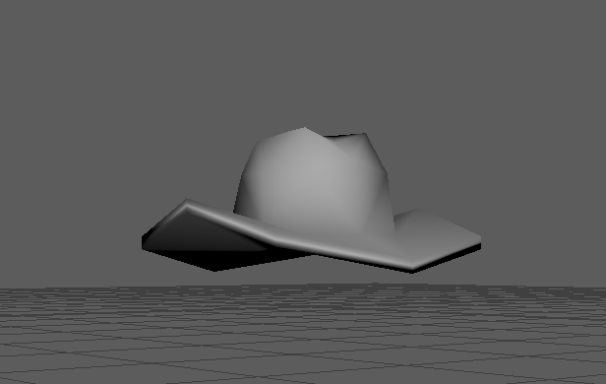
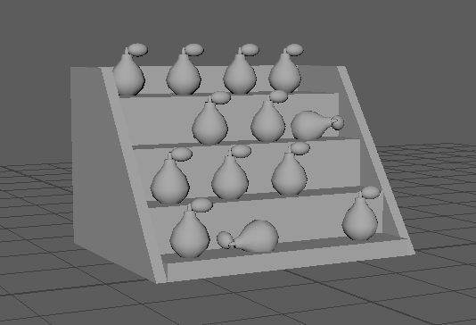
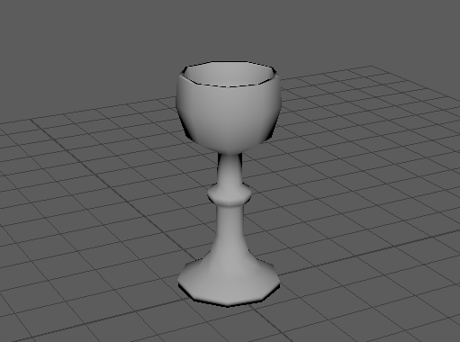
Prototype models

Slide 5
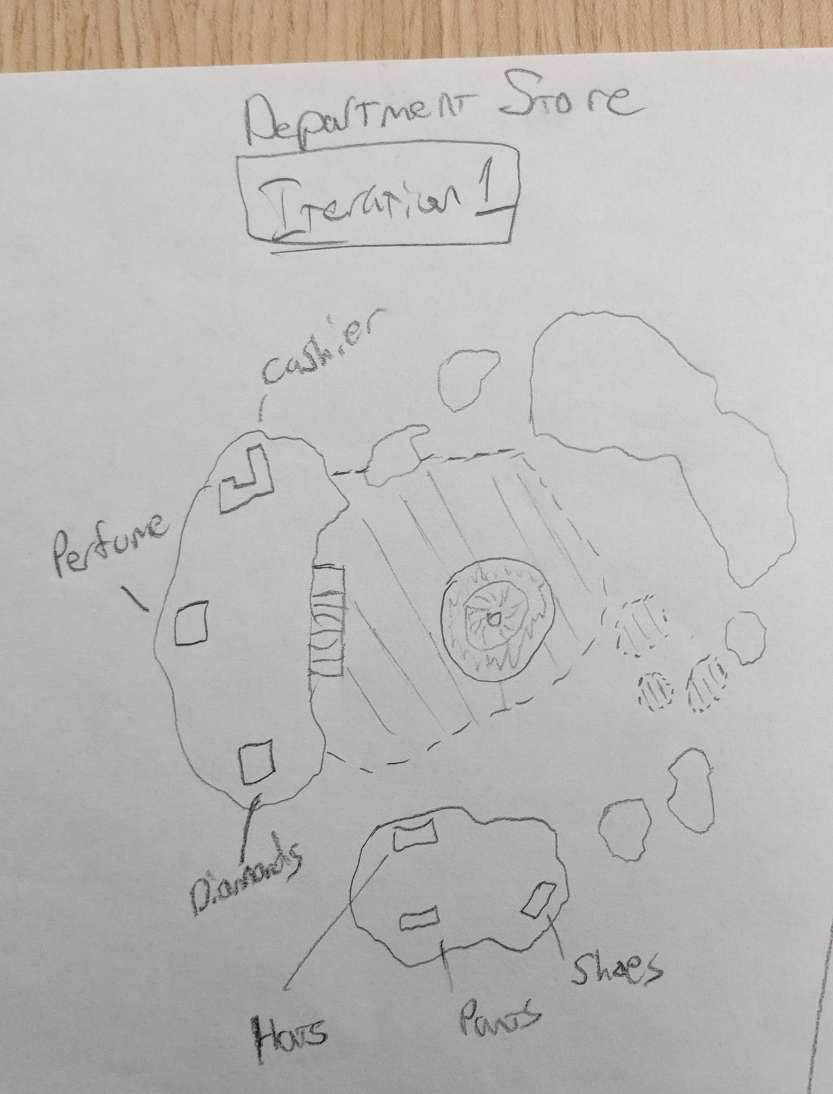
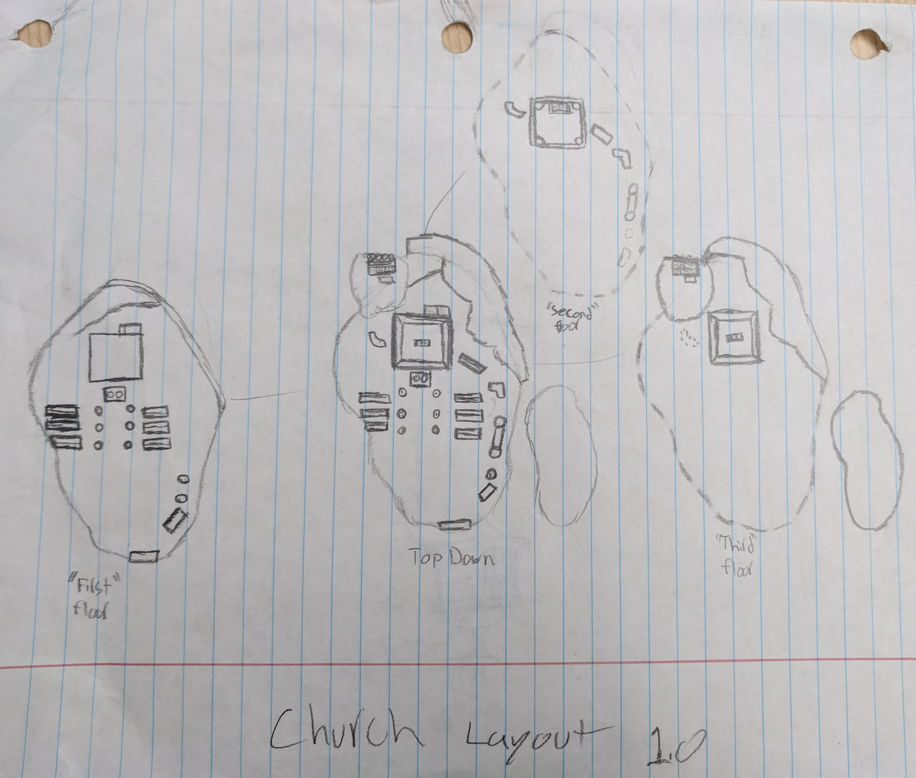
Level Designs

Slide 6
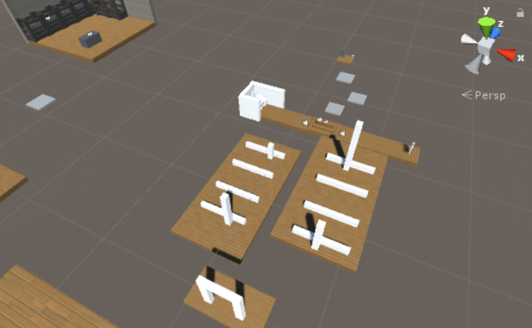
White blocking

Slide 7

Nanocon prototype

Slide 8
Questions?

